Slide 1
MADHAV INSTITUTE OF TECHNOLOGY & SCIENCE, GWALIOR
(A Govt. Aided UGC Autonomous & NAAC Accredited Institute Affiliated to RGPV, Bhopal)
Department of CSE & IT
Minor Project
(150505)
Event check-in system by Facial Recognition
SUBMITTED TO: SUBMITTED BY:
Prof. Khushboo Agarwal Kapil Patel
( 0901CS181050 )
Prof. Neha Bhardaj Karan Sharma
( 0901CS181051 )
Prof. Julie Kumari Karishma Raghuwanshi
( 0901CS181052 )

Slide 2

Project Description
Digital Invitations Through email, message and whatsapp(Manually)
Guests registration through Registration Form or by Event-Admin
Guests Management (List Preparation) and Training
Event Check-in System by Facial Recognition
Face Detection and Image Capturing
Checks if the image of the person is present in database
Gets the response
If image is present in the database, then will mark attendance
Else notify the owner(Admin)
Unknown Guests image will be added in database(Unknown Section)
We’ll first perform face detection, extract face embeddings from each face using deep learning, train a face recognition model on the embeddings, and then finally recognize faces in both images and video streams with OpenCV

Slide 3
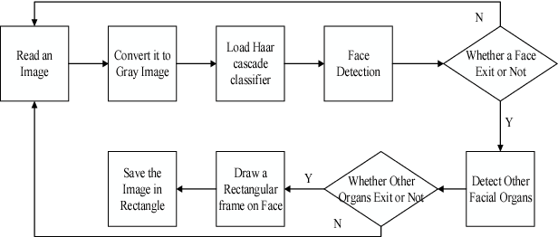
Working
A computer program that decides whether an image has faces or not , is called a classifier.
OpenCV provides us with two pre-trained and ready to be used for face detection classifiers:
HAAR classifier
LBP Classifier
Classifiers processes images in gray scales.
NOTE:-Here in project we are using LBP classifier.

Slide 4

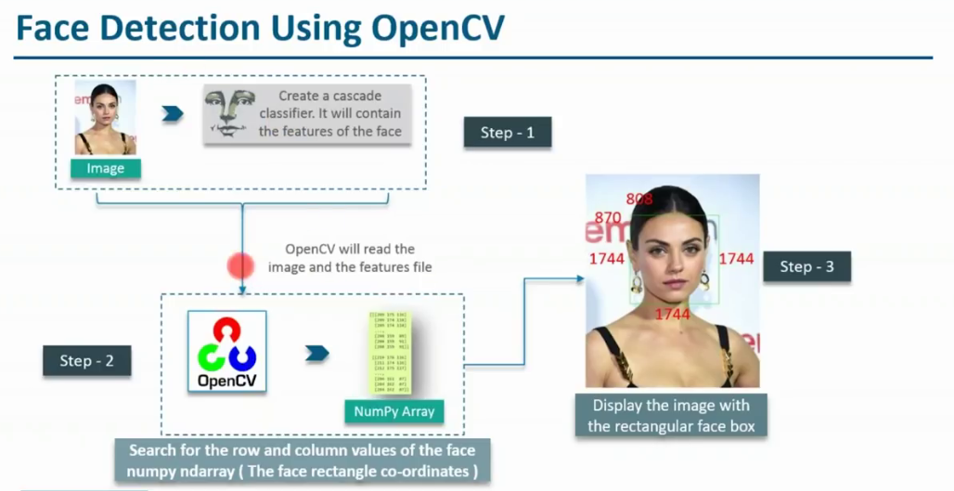
Working
OpenCV is an open source computer vision library that has three built-in face recognition algorithms, Eigenfaces [ 7 ] , Fisherfaces [8] and Local Binary Pattern Histogram (LBPH) [9] .
NOTE:-Here,in project we are using Local Binary Pattern Histogram (LBPH) in our project.

Slide 5
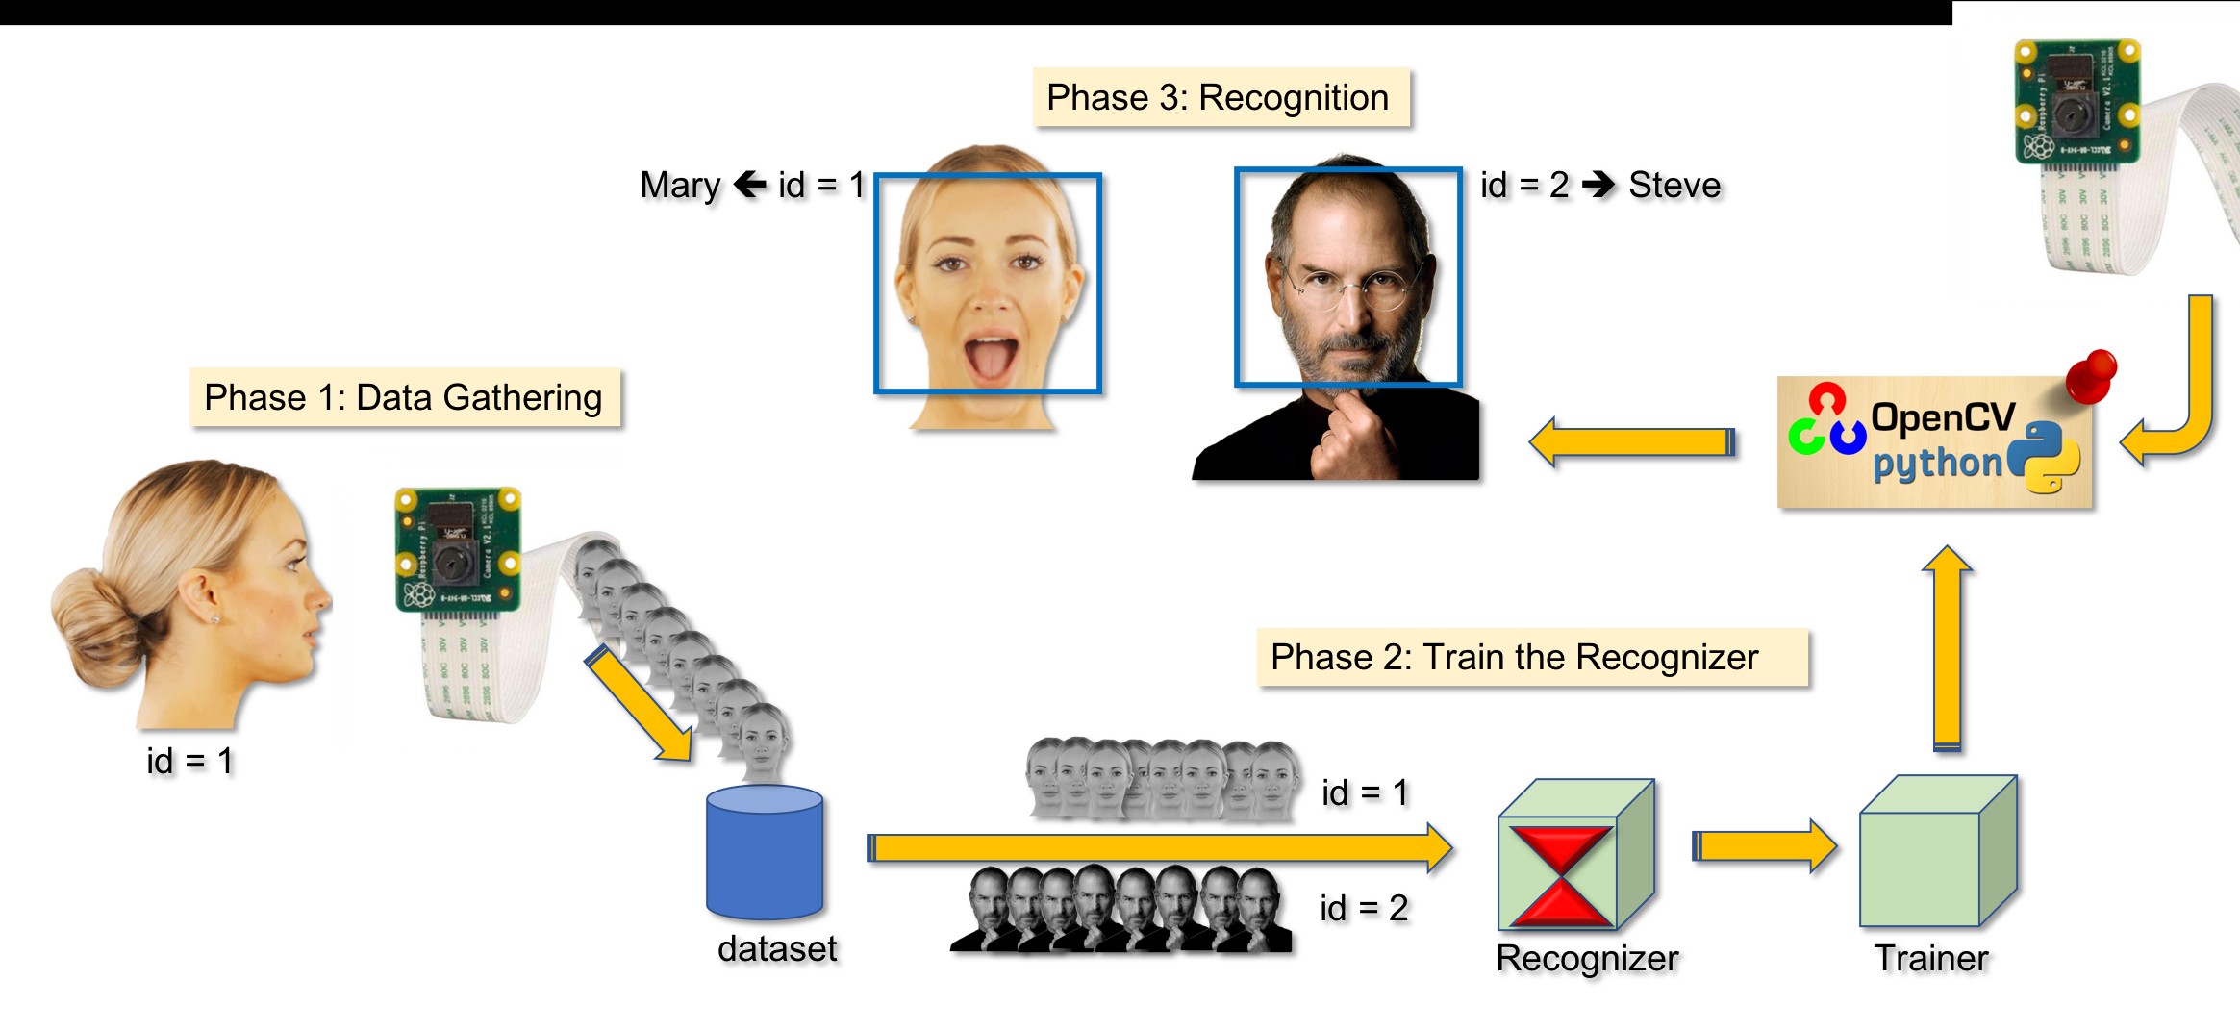
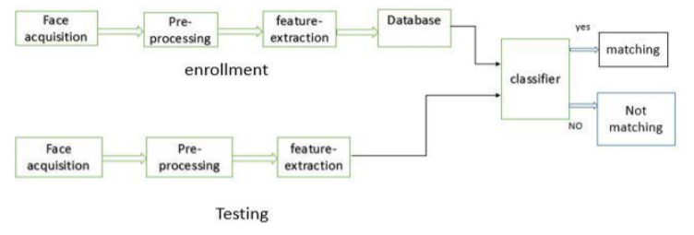
Working

Slide 6
Languages used in project
Front End Languages |  | Back End Languages
Name | Description | Name | Description
Python Packages used: Django Tkinter | Whole online frame work Whole offline frame work | Python Packages used: 1.DJANGO 2.FACE-RECOGNITION 3.OPEN-CV 4.NUMPY 5. PyMySQL | (Dynamic database-access) (Recognize and manipulate faces) (image processing functions) (numerical operations, Numpy arrays) (is an interface for connecting to a MySQL database server from Python)
DATABASE Details
1.We are using MySQL for database and to add, access, and process data stored in a computer database, we are using MySQL Server. 2.Database named as Event is created. 3.It contains 3-tables ( guests, unknowns, attendance). 4.Guests table contains following attributes (Guest No, Name, Email, Gender, Contact, DOB, Address, Photo). 5.Unknowns table contains following attributes (Serial No, Name, Email, Contact, Photo). 6.Attendance table contains (Serial No., Name, Date, Time). 7.All tables data can be managed( Add, Update , delete) by Admin, and guests are able to fill entry only.

Slide 7
Team Members Role in Project
Member Name | Role
Kapil Patel | Front-end :-Whole Tkinter Frame Offline frame work(Coding), Back-end :-Implementation of Face recognition Functions ,Attendance Functions , Algorithms(coding). Implementation of Notification Library.
Karan Sharam | Front-end :-Whole Online Frame Work Guest registration page. Online invitation to the guest through email or contact no. given at the time of registration. Admin Login page. Back-end :-Implementation of image processing , fetching, storing functions
Karishma Raghuwanshi | Front-end :-Whole Tkinter Frame Offline frame Themes (Suggestion , Idea of frame and its attributes) Back-end :-Implementation of whole Database Connectivity, Creation, Sql Queries Implementations

Slide 8
Project distribution on the basis of Modules
Module Name | Work | Functions Used
Main Page ( Login Page) | Login System for Admin (Contains Login and Forget buttons) 2.Register Button :-allow Guests to register . 3.Scan Image Button :Will allow face detection and recognition, Marking of attendance ,Detection Unknown Guests | Login, Register, Forget, scan
Menu page | Allows accessing different frame 1.Guest Management System 2.Train your machine Functions 3.Attendance Management System 4.Unknown Guests Data | Logout Frame fetching Functions
Guest Management System | Allows admin to fetch ,add ,delete ,update Guests data | Back to Menu Add, Delete, Update, Clear
Train your machine Functions | Allows admin to fetch data from Guests Photo data from database, train a face recognition model on the embeddings
Attendance Management System | Allows admin to fetch ,delete ,update Guests attendance data | Back to Menu Delete, Update, Clear
Unknown Guests Data | Allows admin to fetch ,delete ,update Unknown Guests data | Back to Menu Delete, Update, Clear
Guests Registration System | Allows Guests to register. | Back to Home Add, Clear
Note:- Here We have divided Modules on basis of Frame work names and their functions accordingly.

Slide 9
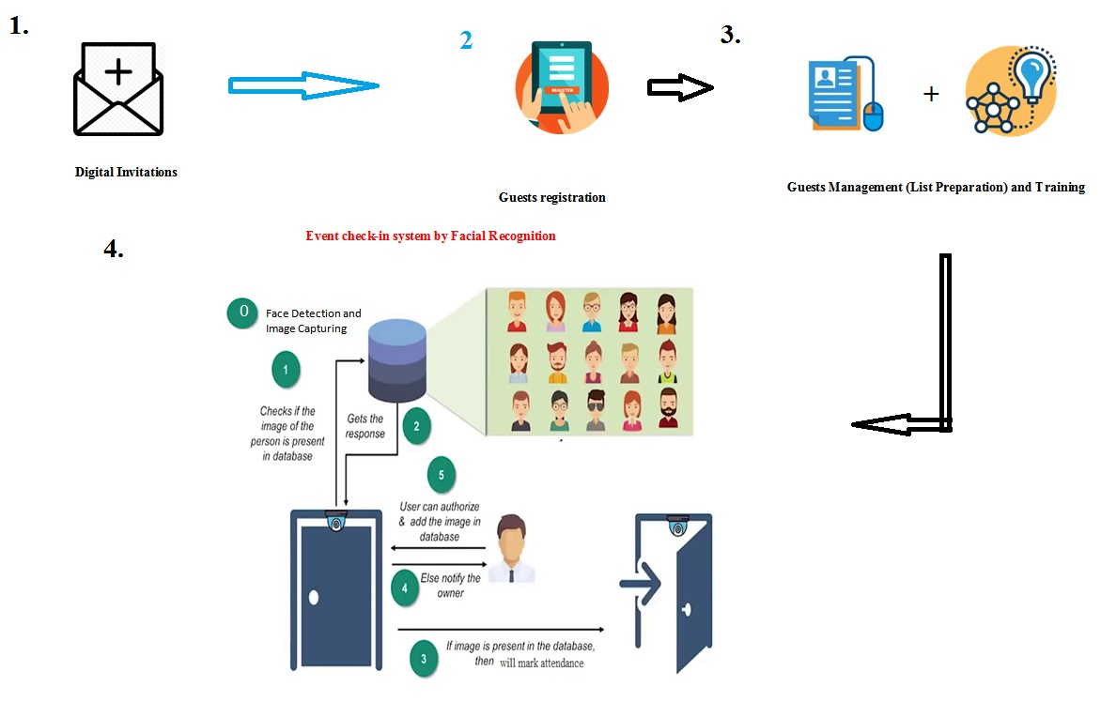
Flow Diagram of Project

Slide 10
Progress up to 25/09/2020
1.We have Completed our frame works( Modules ) almost all.
2.We are able store , fetch data ,process data(Training and face recognition).
We are able mark attendance of Known guests and filter Unknown (able to store their data too.)

Slide 11
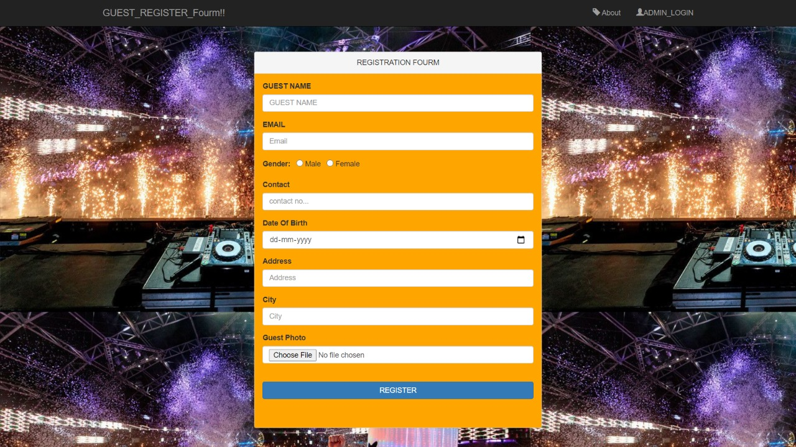
Guest Online Registration Form

Slide 12
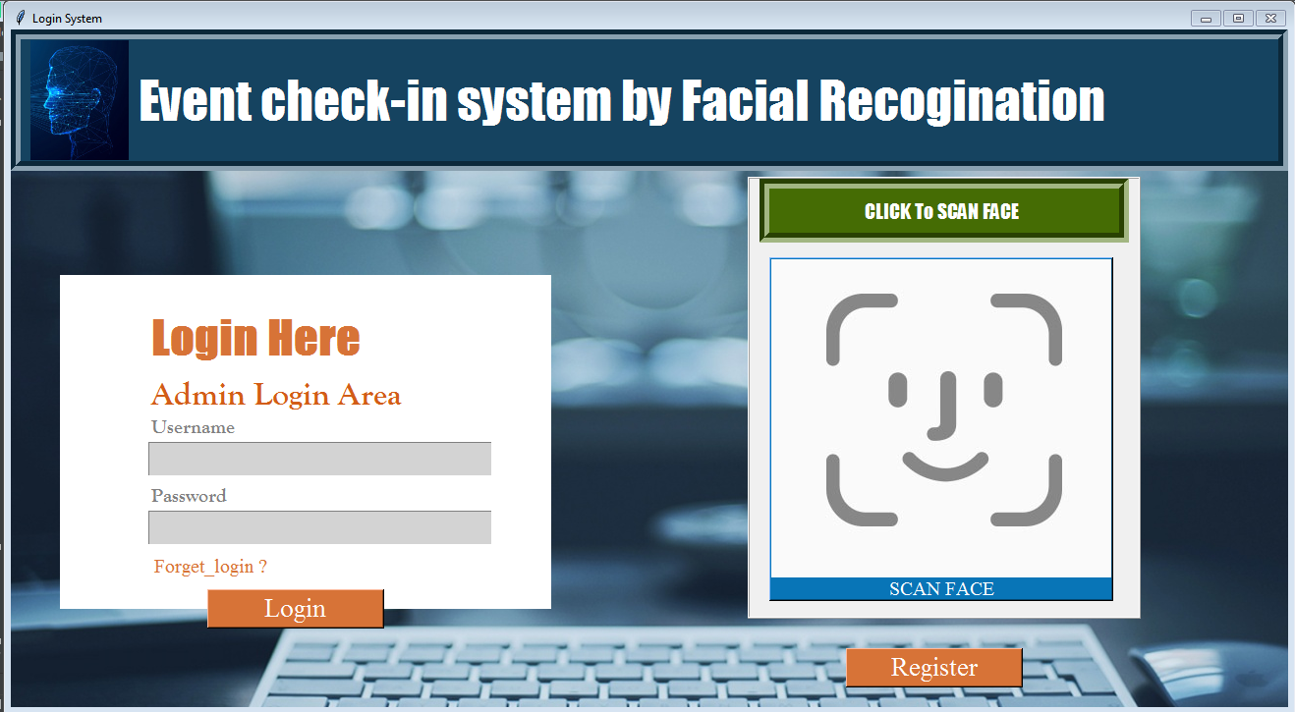

Slide 13
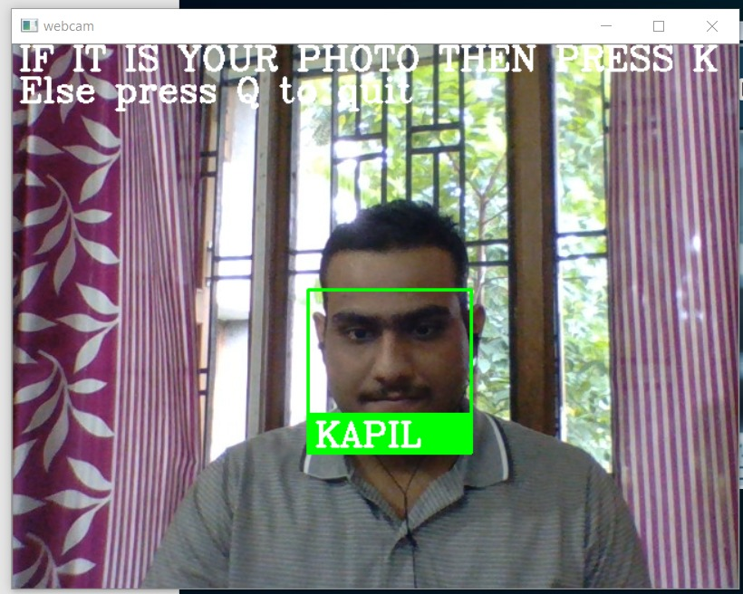

Slide 14
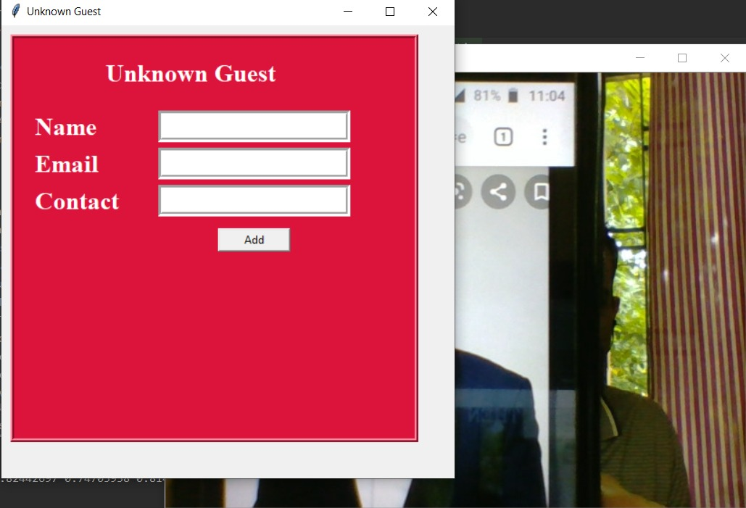

Slide 15
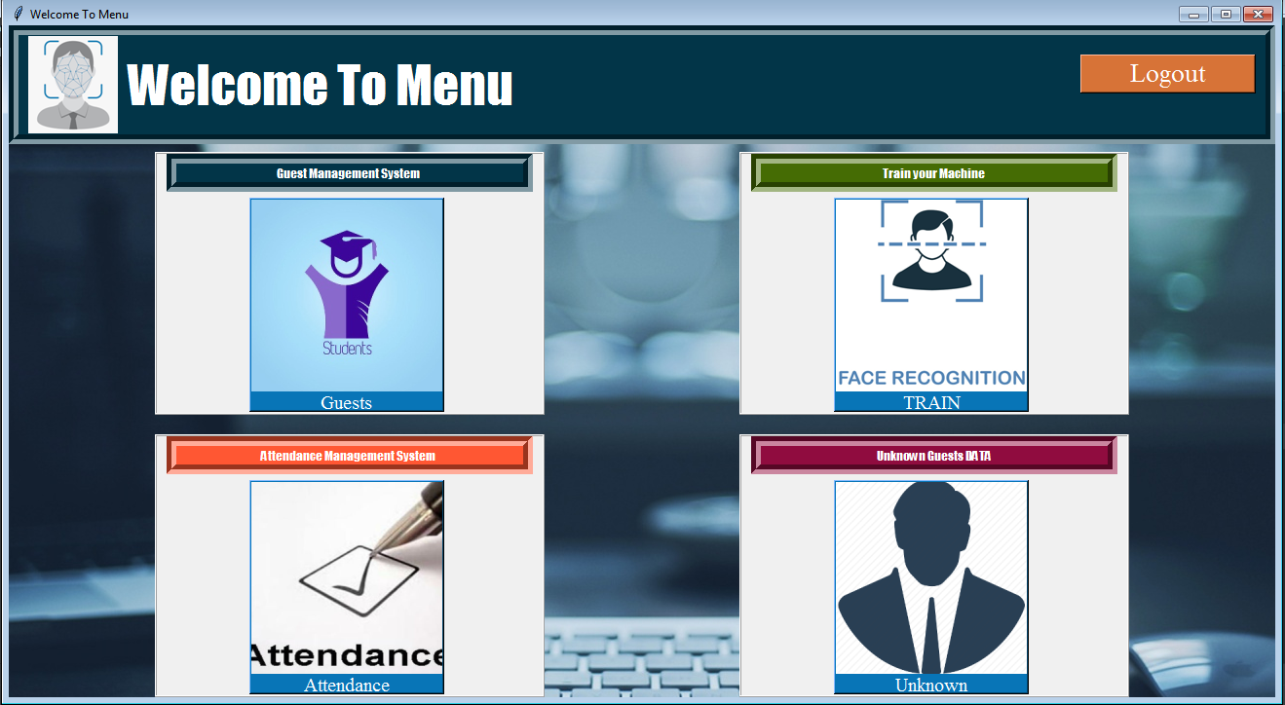

Slide 16
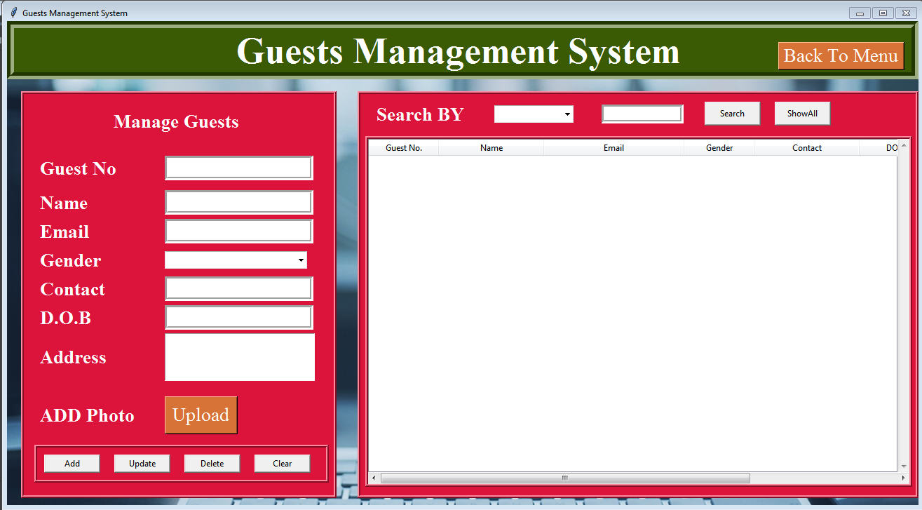

Slide 17
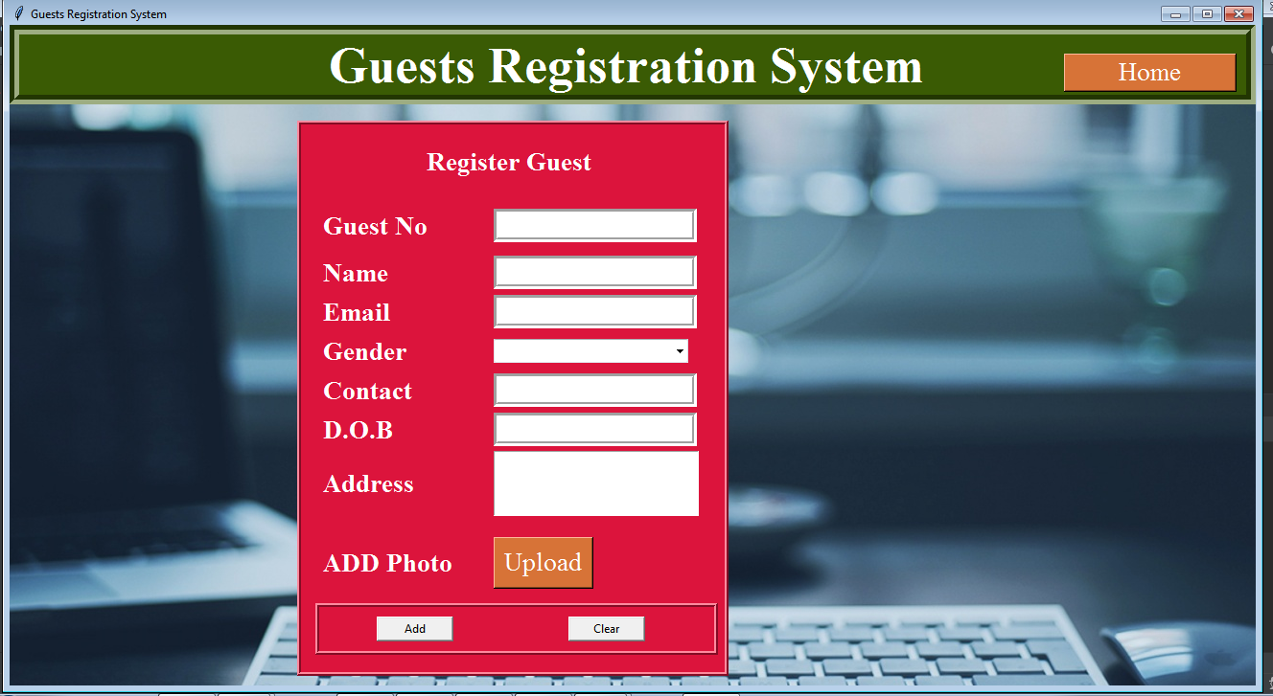

Slide 18
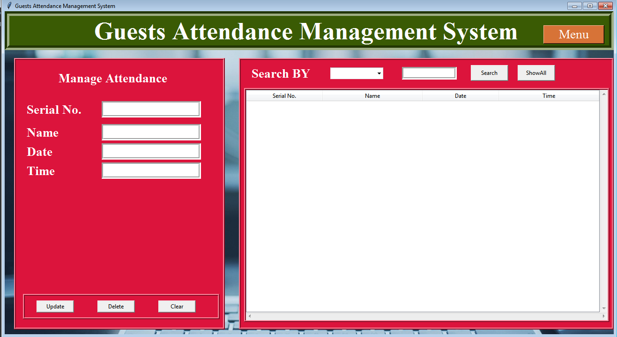

Slide 19
